Slide 1
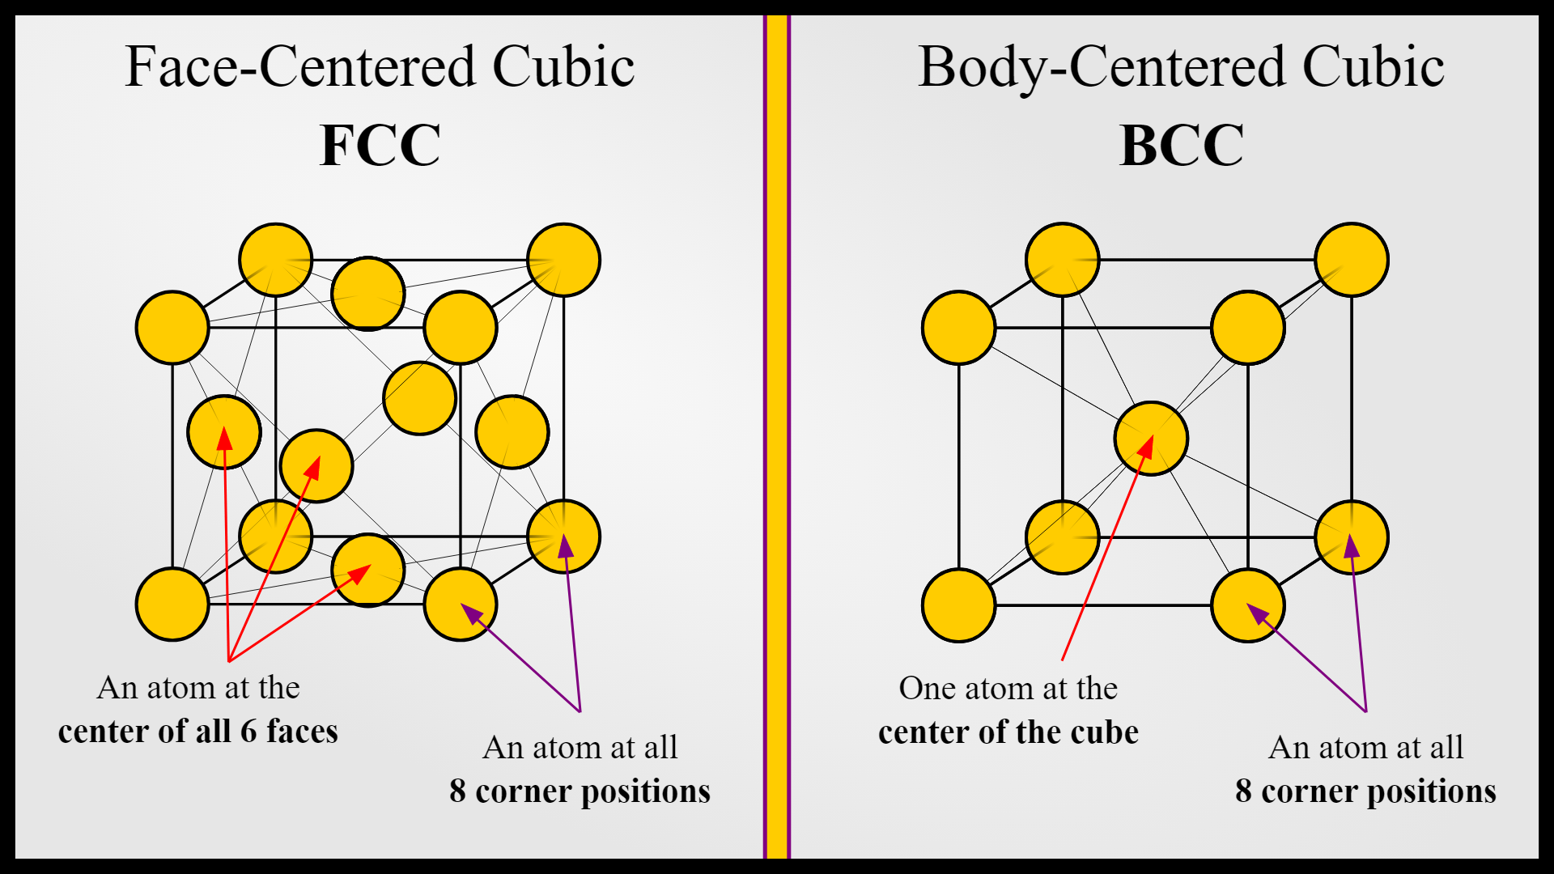
We model the O atoms as BCC about a reference Oxygen atom
Model
https://msestudent.com/what-is-the-difference-between-fcc-and-bcc-crystal-structure-properties-interstitial-sites-and-examples/
: O atom

Slide 2
Defect interaction LUT
N = 1 defect
: defect
: reference O atom
Subtotal
Case 1
Total
Case 1

Slide 3
Defect interaction LUT
N = 2 defects
Subtotal
Case 1
Case 2
Case 3
Total
Case 2
Case 3
Case 4

Slide 4
Defect interaction LUT
N = 3 defects
Subtotal
Case 1
Case 2
Case 3
Case 4
Total
Case 5
Case 6
Case 7
Case 8

Slide 5
Defect interaction LUT
N = 4 defects
Subtotal
Case 1
Case 2
Case 3
Case 4
Total
Case 9
Case 10
Case 11
Case 12
Subtotal
Case 5
Case 6
Case 7
Case 8
Total
Case 13
Case 14
Case 15
Case 16

Slide 6
Defect interaction LUT
N = 5 defects
Subtotal
Case 1
Case 2
Case 3
Case 4
Total
Case 17
Case 20
Case 18
Case 19

Slide 7
Defect interaction LUT
N = 6 defects
Subtotal
Case 1
Case 2
Case 3
Total
Case 21
Case 22
Case 23

Slide 8
Defect interaction LUT
N = 7 defect
: defect
: reference O atom
Subtotal
Case 1
Total
Case 24

Slide 9
Defect interaction LUT
N = 7 defect
: defect
: reference O atom
Subtotal
Case 1
Total
Case 25

